Slide 1
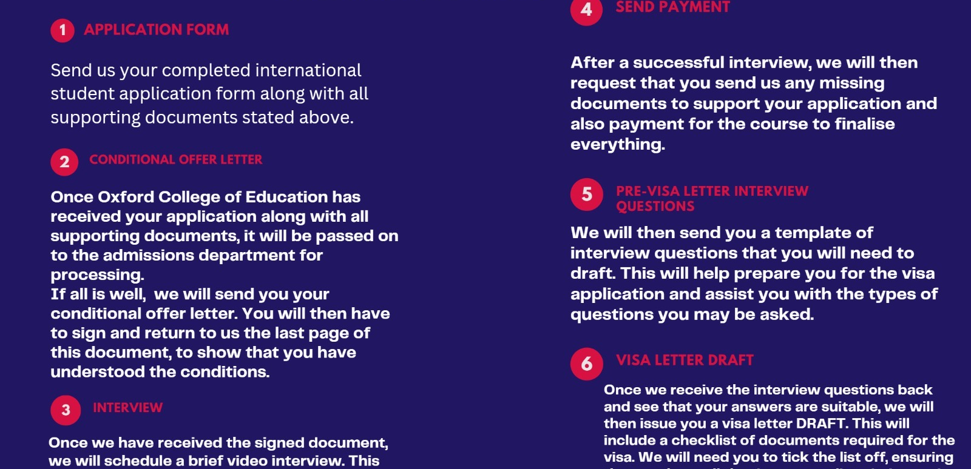

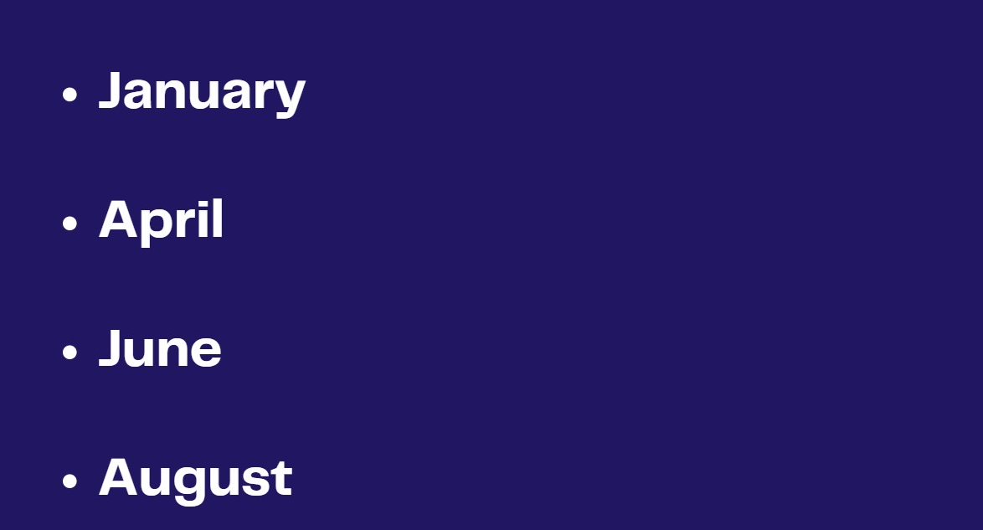
STUDY ENGLISH
in the UK
Course process
A simple customer guide to the legal English-study route, course levels, intakes, costs, and the application process.
Budget planning
For serious students
English study first. Clear guidance. Honest process.
Use this deck in consultations, WhatsApp follow-ups, and community presentations.
Main intakes
Notes:
[Sources]
- User-provided image: /mnt/data/12187AA4-8240-42D6-9B40-110E7003C667.jpeg
- User-provided image: /mnt/data/8EAB4133-28DF-4B7D-9D24-E9A112C4BABD.jpeg
- User-provided image: /mnt/data/F8EE24B4-2D74-4126-AF73-9A582AB4F446.jpeg
[/Sources]

Slide 2
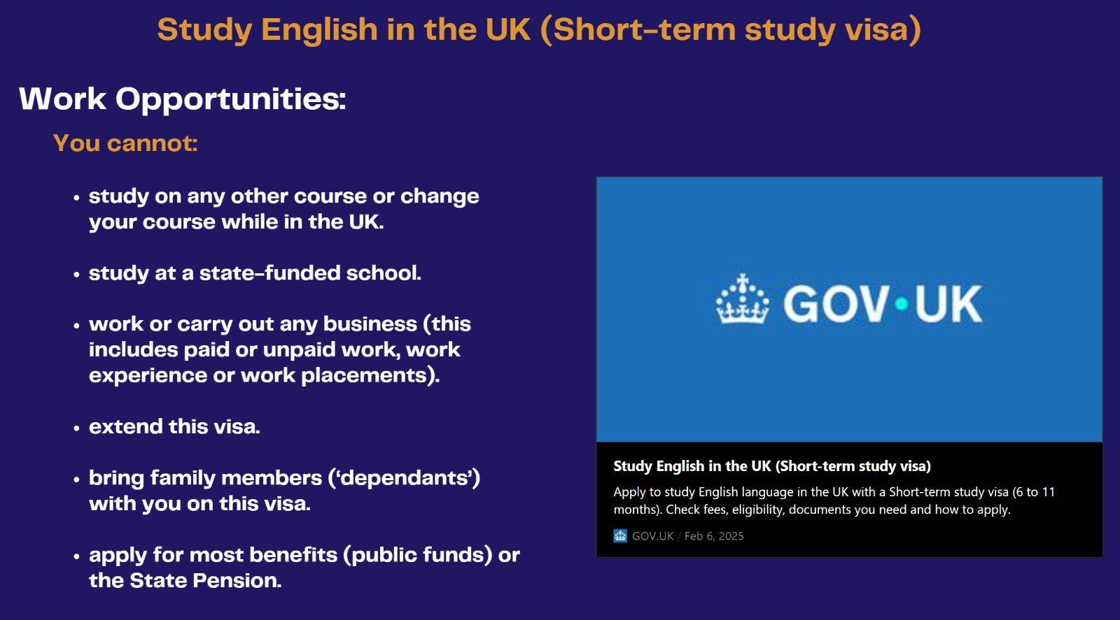
OVERVIEW
What this programme offers
Study English in the UK through a legal route for courses lasting more than 6 months and up to 11 months.
Improve everyday English, academic English, or business-focused English depending on your current level and goal.
Stay for the course length plus up to 30 extra days, as long as the total stay does not go over 11 months.
The route is for English language study - not a work route.
Receive structured admissions support: eligibility check, document guidance, application support, and interview preparation.
This is strongest when marketed as education first: legal study, language improvement, structure, and honesty.
Admissions support for legal English study in the UK
Notes:
[Sources]
- https://www.gov.uk/visa-to-study-english
- https://www.gov.uk/visa-to-study-english/eligibility
- User-provided image: /mnt/data/7967E22F-E790-4D77-994B-694D9811B711.jpeg
[/Sources]

Slide 3
COURSE LEVELS
Choose the right English level
1
2
3
English for
Beginners
English for
Intermediate Learners
English for
Business and Education
For students with little or no confidence in English who want to improve speaking, listening, reading, and writing for daily life.
For students who already know some English and want more fluency, stronger grammar, clearer communication, and more confidence.
For students or professionals who want formal English for work, study, presentations, interviews, and academic progression.
Students should be guided to the most suitable level after an initial assessment.
Students should be guided to the most suitable level after an initial assessment.
Students should be guided to the most suitable level after an initial assessment.
Admissions support for legal English study in the UK
Notes:
[Sources]
- Course-level wording synthesized from user instructions and Oxford course materials: https://oxfordce.co.uk/courses-and-admissions-process/
[/Sources]

Slide 4
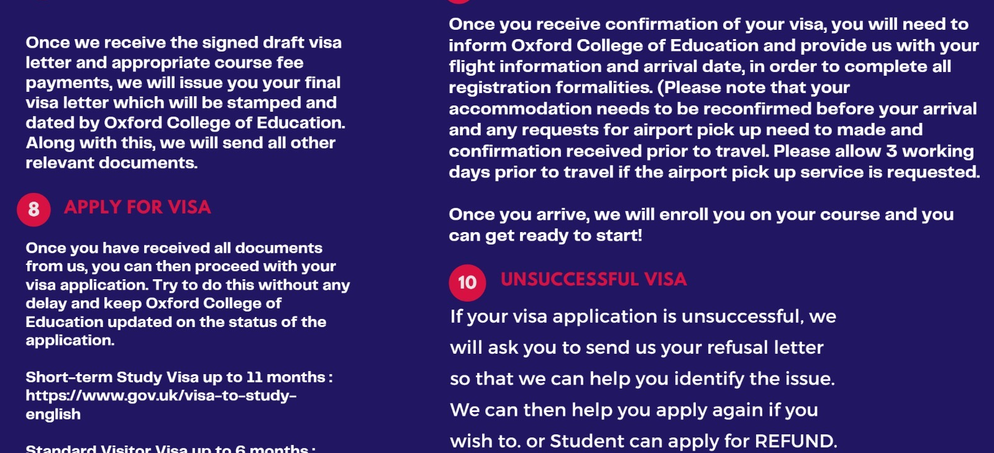
STEP BY STEP
How the process works
1
Complete initial assessment
2
Choose the best English level and intake
3
Prepare passport, academic records, CV, statement, and references
4
Submit the application and receive a conditional offer
5
Prepare for interview, payments, and visa file
6
Travel to the UK and begin your studies
Admissions support for legal English study in the UK
Notes:
[Sources]
- https://oxfordce.co.uk/admission-process/
- User-provided image: /mnt/data/12187AA4-8240-42D6-9B40-110E7003C667.jpeg
- User-provided image: /mnt/data/DAFF231C-7BC7-4877-B654-A17E4687B3EE.jpeg
[/Sources]

Slide 5
DOCUMENTS
Typical documents students may need
•
Valid passport with enough validity
Best practice
Updated CV / resume
Collect and check every document early. Most delays happen because files are missing, unclear, or inconsistent.
•
•
Academic certificates and transcripts
•
Personal statement or study explanation
Use a simple checklist for each student so nothing is missed before submission.
•
Reference letters where requested
•
Proof of funds or sponsor evidence
Always be honest: final admission decisions belong to the school and final visa decisions belong to the UK authorities.
•
Accommodation / travel planning evidence where needed
•
Proof of course payment or ability to pay
Admissions support for legal English study in the UK
Notes:
[Sources]
- https://oxfordce.co.uk/admission-process/
- https://www.gov.uk/visa-to-study-english/documents-you-must-provide
[/Sources]

Slide 6
PLANNING
Budget overview and main intakes
Typical cost categories
Main intakes shown by the school
School tuition
from £7,950
January
April
June
UK visa fee
£228
August
November
Immigration Health Surcharge
usually £776
VFS / travel / accommodation
varies
Keep your service fee separate from school and government charges. Transparency builds trust.
Admissions support for legal English study in the UK
Notes:
[Sources]
- https://oxfordce.co.uk/courses-and-admissions-process/
- https://www.gov.uk/government/publications/visa-regulations-revised-table/home-office-immigration-and-nationality-fees-8-april-2026
- https://www.gov.uk/visa-to-study-english
- User-provided image: /mnt/data/F8EE24B4-2D74-4126-AF73-9A582AB4F446.jpeg
[/Sources]

Slide 7
HONEST MESSAGING
Important rules students must understand
This route is for English study only.
Use wording like this:
We help international students apply to study English in the UK through a clear, legal, and structured admissions support service.
Students cannot work or run a business on this route.
Students cannot bring dependants under this route.
This wording is stronger, safer, and easier to trust than selling a visa or making promises you cannot control.
Students cannot extend this visa or switch to another route from inside the UK.
Your marketing should sell education first, not a promise of migration outcomes.
Admissions support for legal English study in the UK
Notes:
[Sources]
- https://www.gov.uk/visa-to-study-english
[/Sources]

Slide 8
Next step for the student
Ready to begin?
Remember
Use this simple call to action in your marketing:
Be clear on what students get:
• legal English-study route
• honest cost breakdown
• guided admissions support
• no false promises
Message us for your eligibility assessment and the next available intake.
Recommended follow-up sequence
1. Send leaflet
2. Collect qualification form
3. Book consultation
4. Start documents
Add your own logo, WhatsApp number, and website before sharing publicly.
Notes:
[Sources]
- Messaging synthesizes user instructions plus cited GOV.UK and Oxford admissions information already referenced in prior slides.
[/Sources]

